Slide 1
Lightning talk
27/NOV/2017
Peripherals
MONITORS
Tamás Kamarás
Green Fox Academy
Corsac Cohort - Badcat Class

Slide 2
Display aspect ratio
4:3 and 16:10 (old computers) till 2003
5:4 (1280×1024 displays) till 2008
16:9 (1920×1080 displays) nowadays
256:135 (4K Cinema quality)

Slide 3
Technologies
Cathode ray tube
Liquid crystal display
Organic light-emitting diode

Slide 4
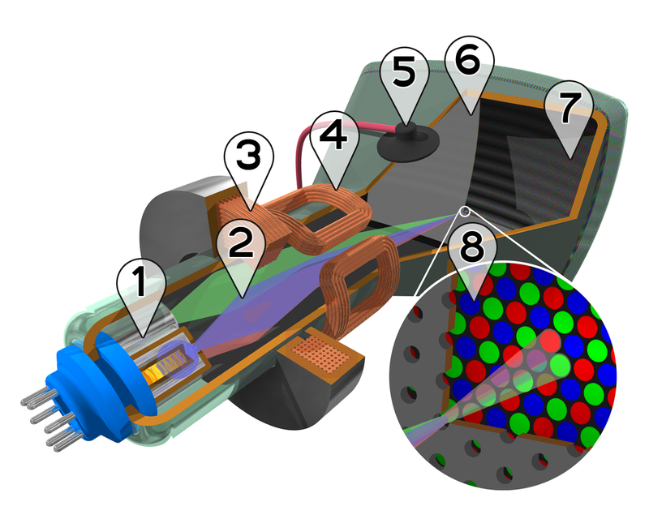
Cathode ray tube

Slide 5
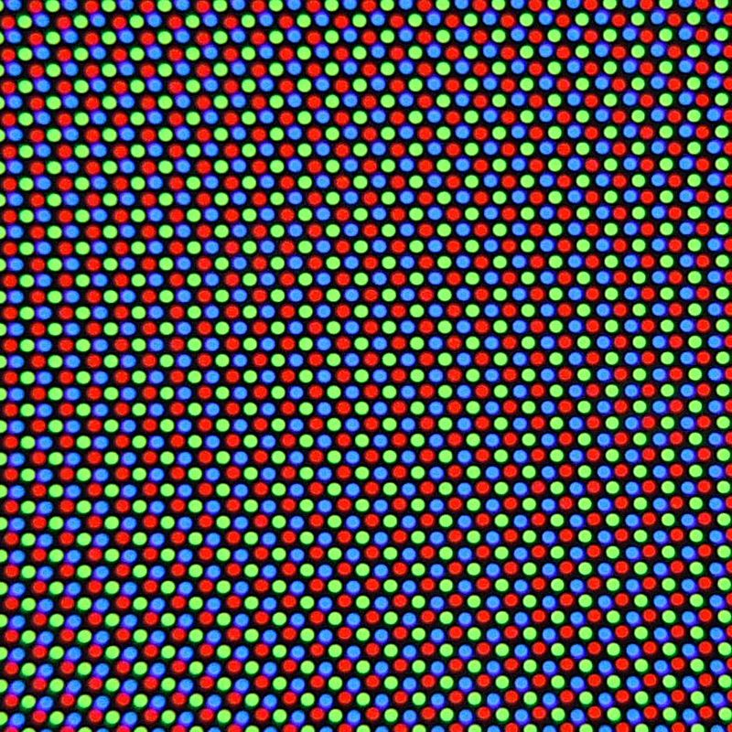
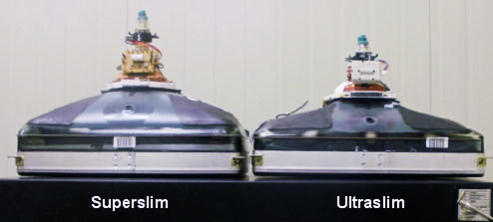
Cathode ray tube

Slide 6
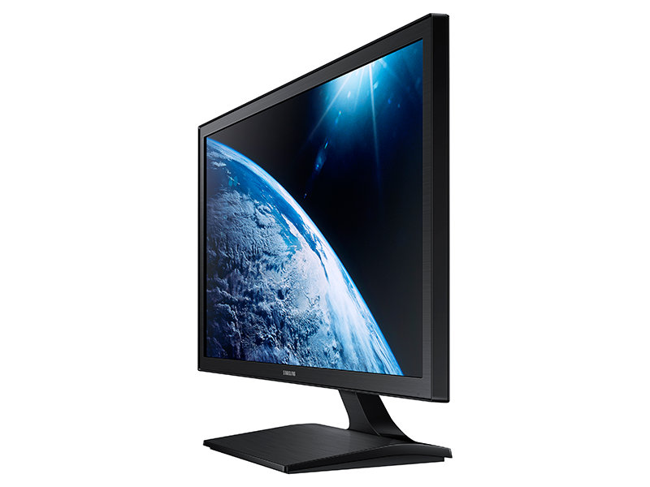
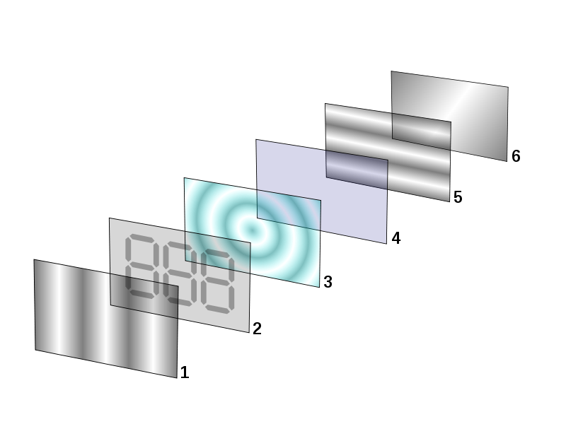
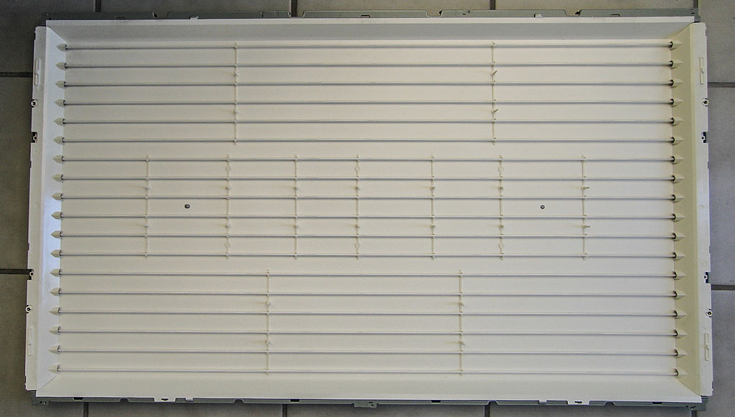
Liquid crystal display

Slide 7
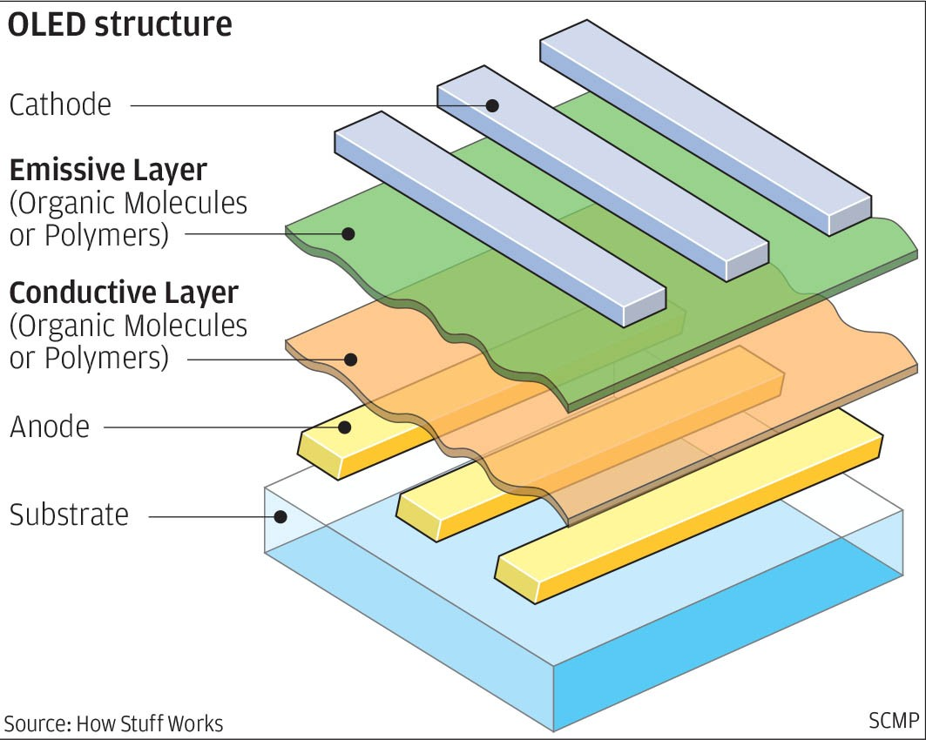
Organic light-emitting diode

Slide 8
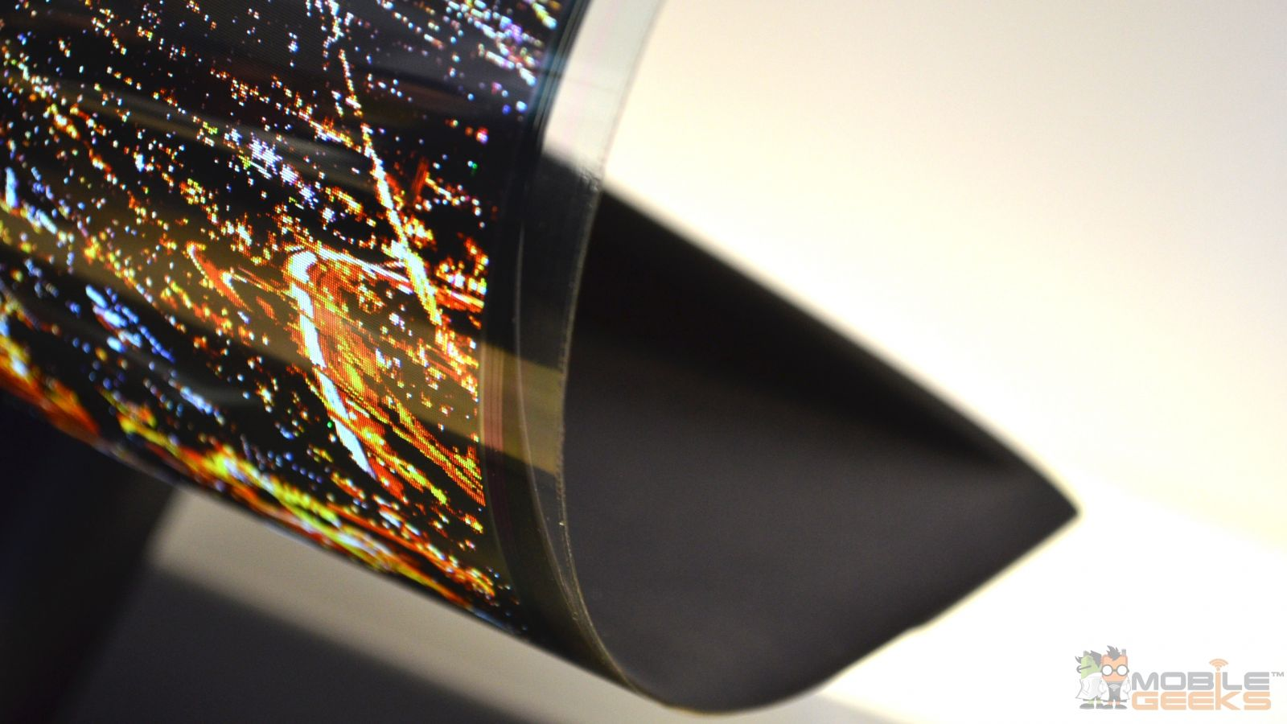
Thanks for watching!

